Slide 1

Git/Github introduction/tutorial Will Buziak 1/11/23

Slide 2
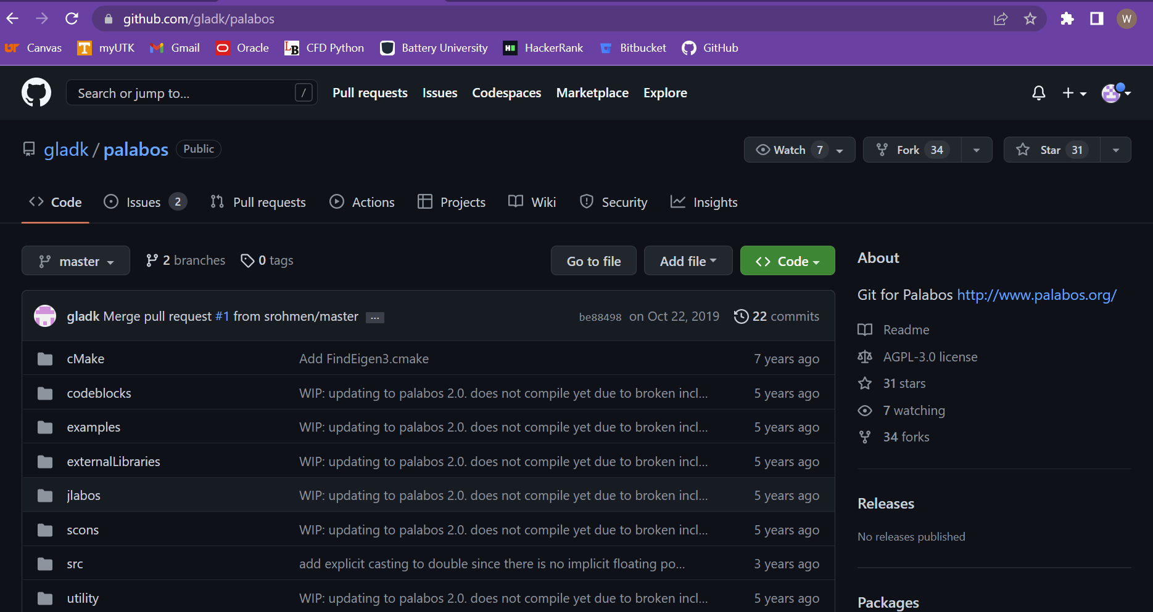
What is Git/Github?
Git is a “form of distributed version control”
Essentially a way to track, collaborate and share “repositories” of programs and files
Operates through the command line in your terminal
Github is a website that hosts Git repositories
Can be used to store, share, and host your files for collaborators or users.
Opensource and easy to use
Github repositories have a user-friendly interface that allows easy navigation and different developer tabs that helps highlight issues or new pull requests

Slide 3
Why Git?
Git was designed for version control. Meaning that there is a well-established record of changes made to each file.
Git allows “cloning” entire repositories of files that can run on a local machine quickly and seamlessly.
Github repos can be specified as public or private and can invite collaborators and adjust permissions
Github hosts remote repositories that are stored online and can be cloned
Proper use of Git creates multiple backups and can be worked on offline
Git/Github is opensource
Git can manage many files at once

Slide 4
Why not other file managers?
Other file managers like Google drive allow for effective file streaming and collaboration
Does not allow for different workflows on the same program
Ideal for files that do not need to be compiled
Difficult to share large directories
Git/Github (and other services like it) tracks previous generations of the same file(s)
Seamless to revert to previous versions
Proper Git usage mitigates overwriting
Allows for multiple “branches” representing different test versions of the same repo that can be merged
Supports “forking” which allows collaborator rights on public repositories they did not previously have writing access to.

Slide 5
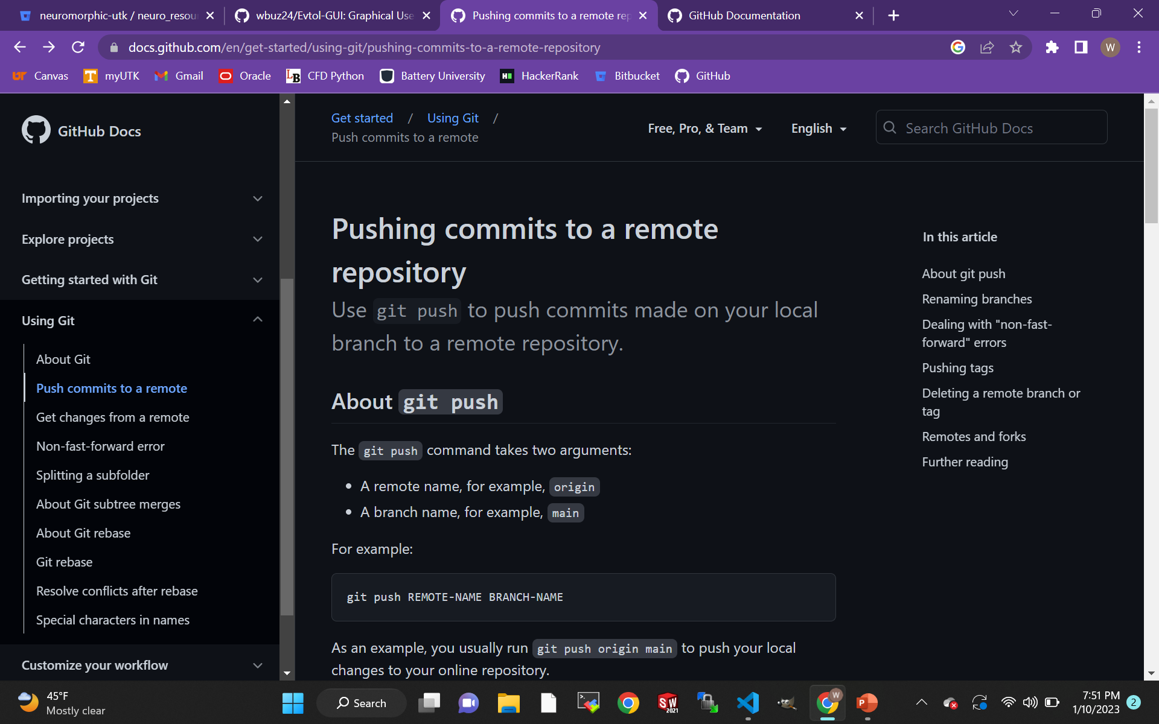
Github Docs is your friend
Note:
Some Git commands perform similar tasks, typically intending to break up the processes of a more confusing command

Slide 6
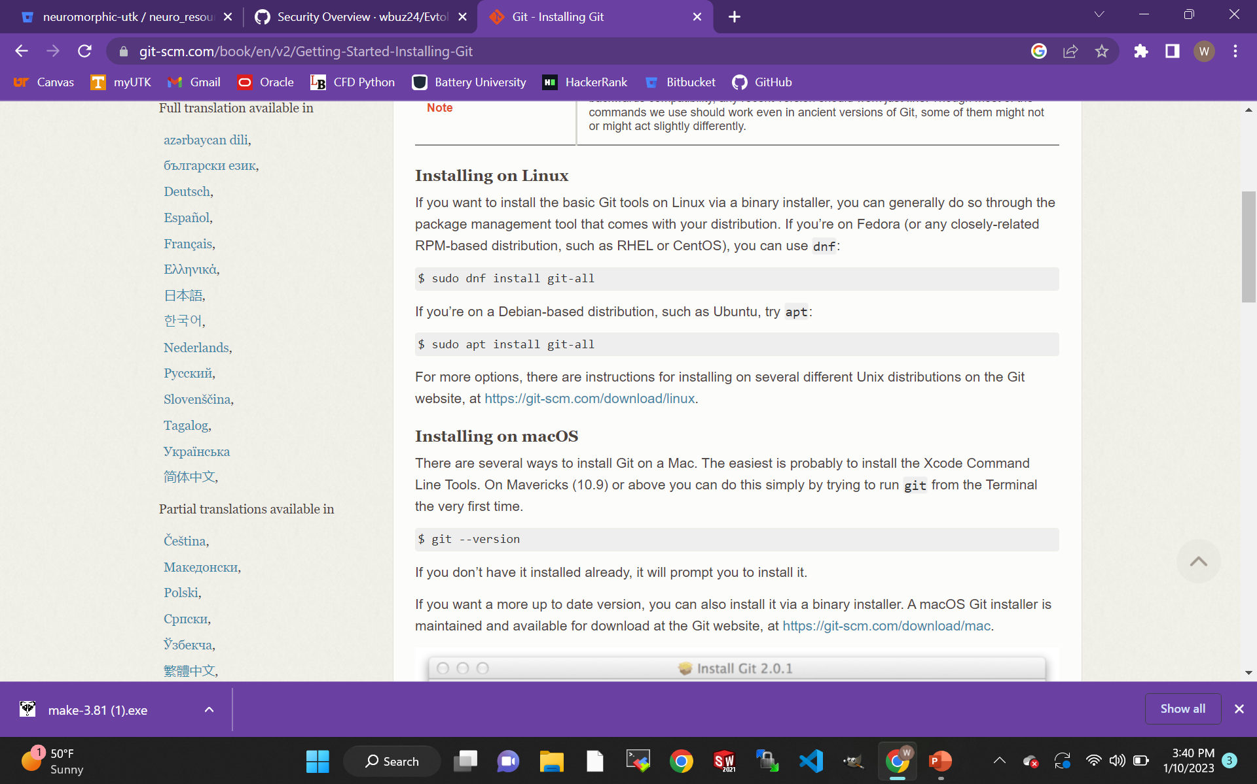
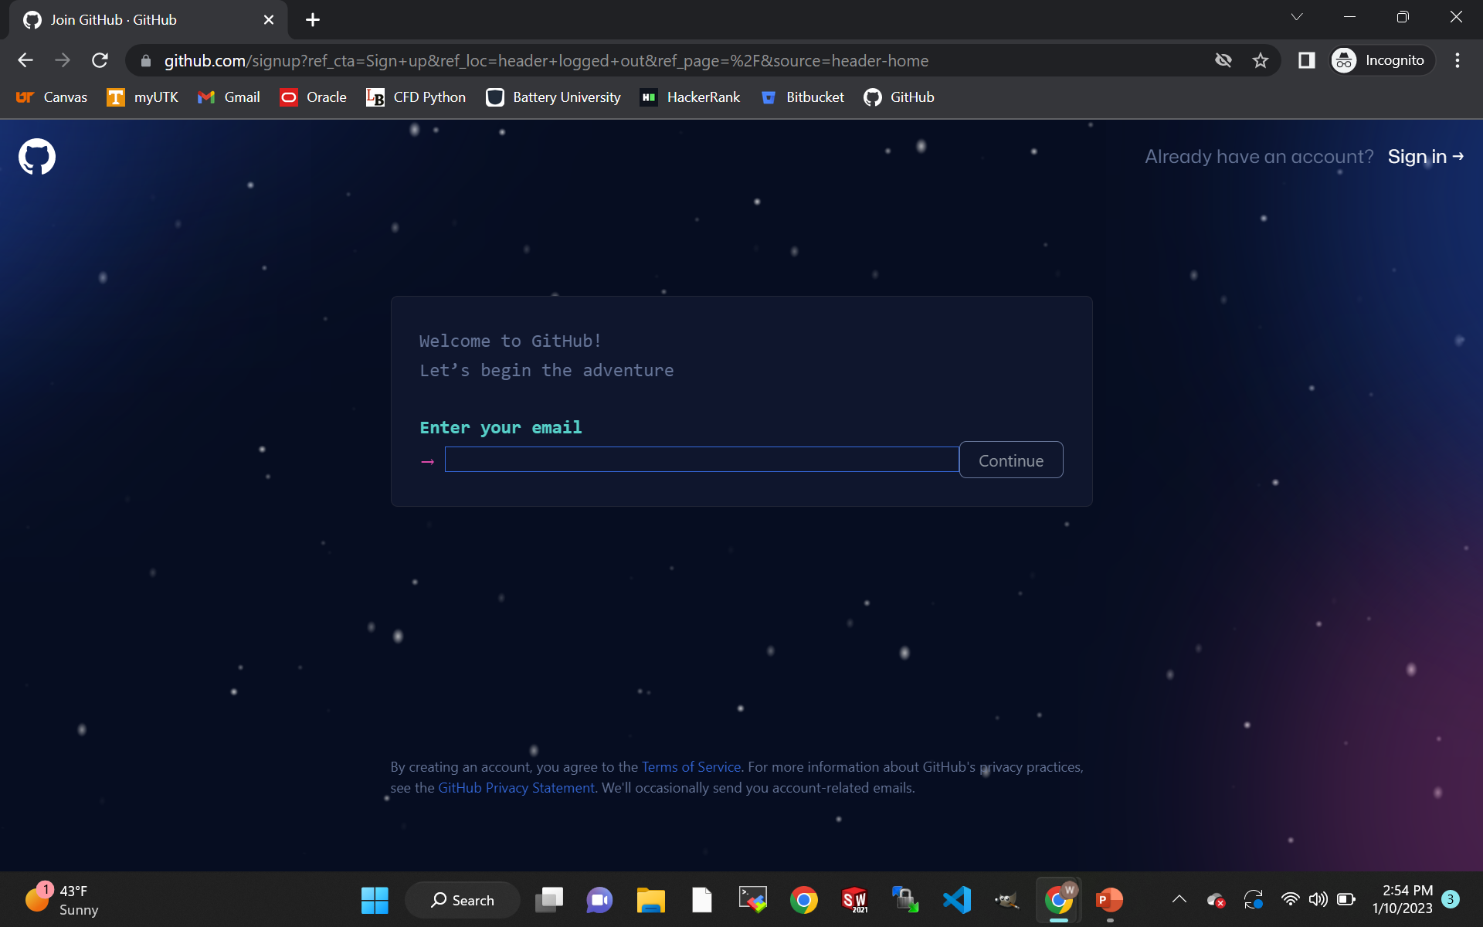
Getting started with Git
Create an account on Github using your school email
Download Git depending on your OS

Slide 7
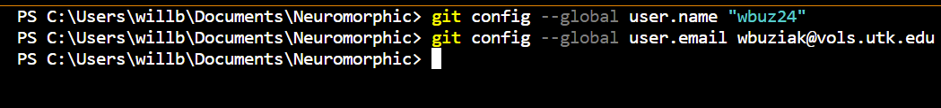
Connect your local Git account with Github
Open your terminal and run the following commands: (“git - -version” will check the version installed)
Configure your username
Configure your school email (use github generated noreply email if preferences are set to private)
“--global” flag configures for every repository on your computer
Now, your local machine will identify you when you push commits to the remote repository

Slide 8
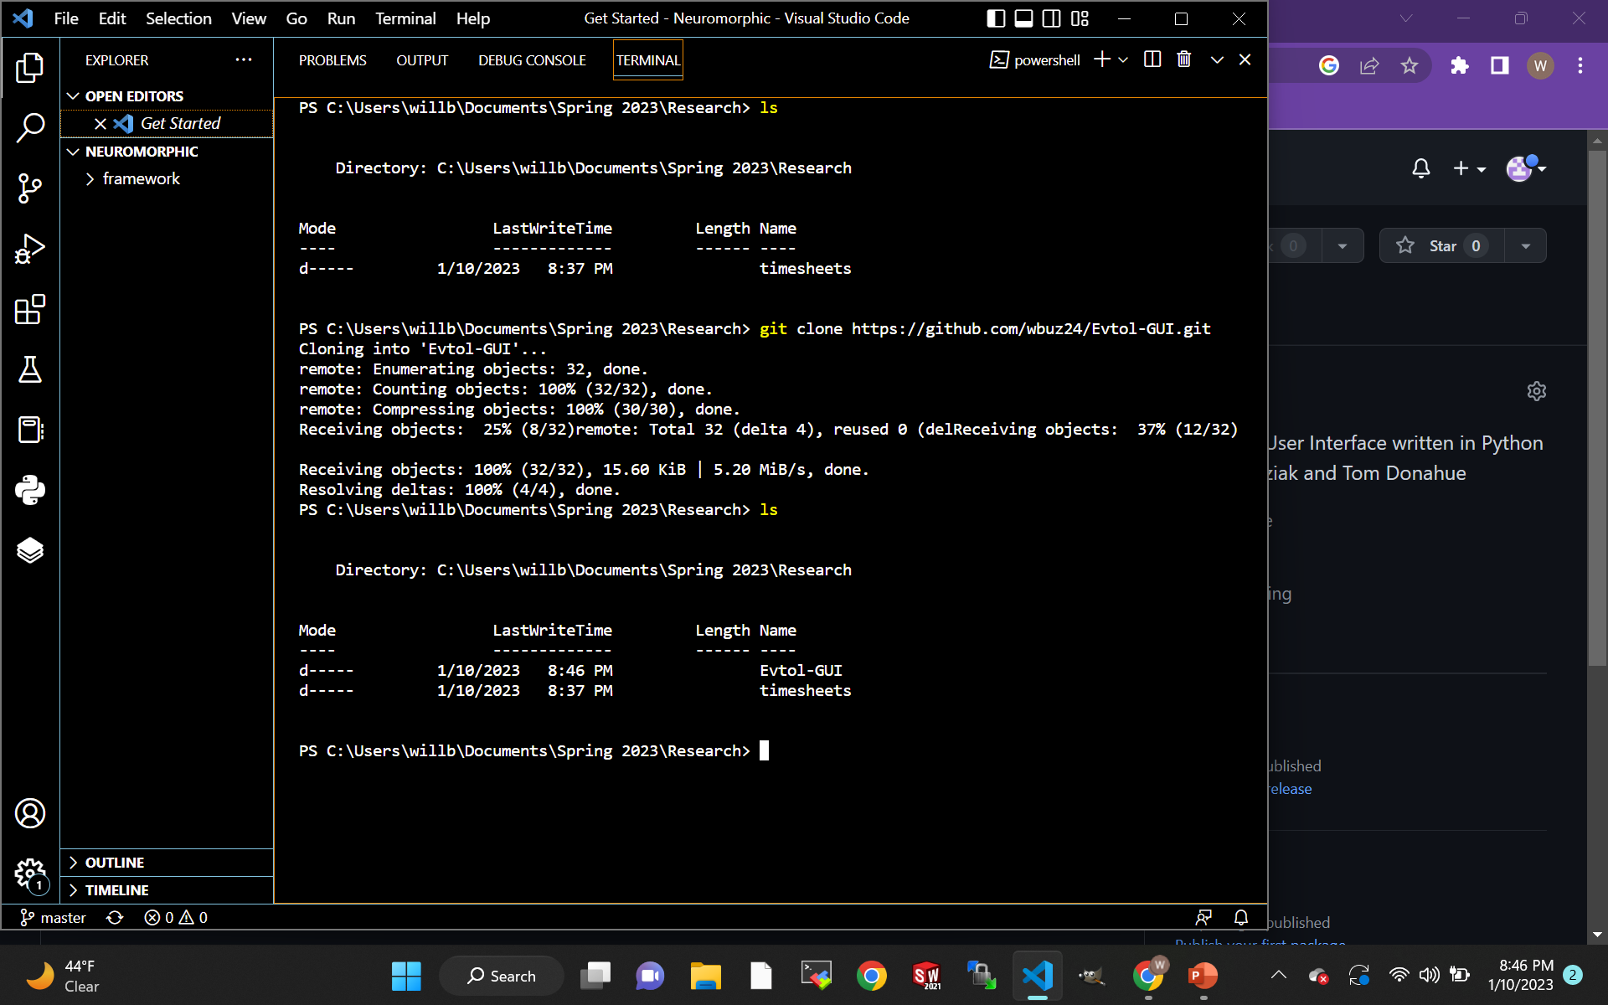
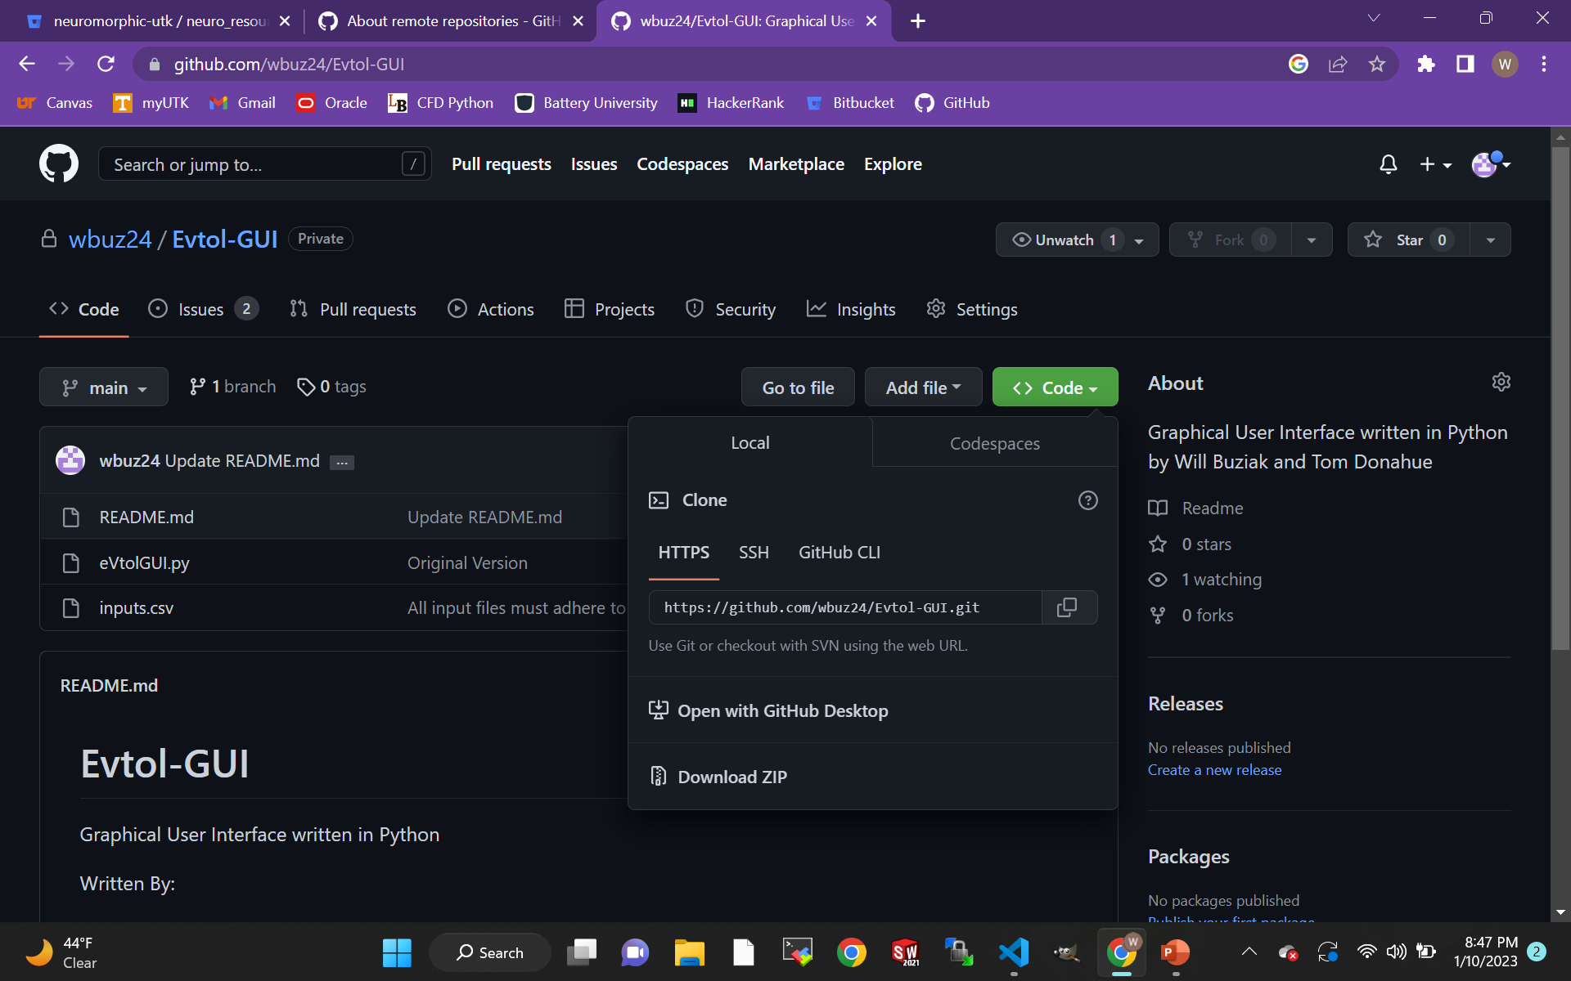
Methods of cloning from a remote with “git clone”
Connecting by SSH keys can be tricky but prevents the need to input your password with each pulling/pushing/cloning.
The easiest way to clone a remote is by using the Github generated HTTPS URLs
Simply copy the URL from the repo on Github
“git clone <URL>” in your terminal

Slide 9
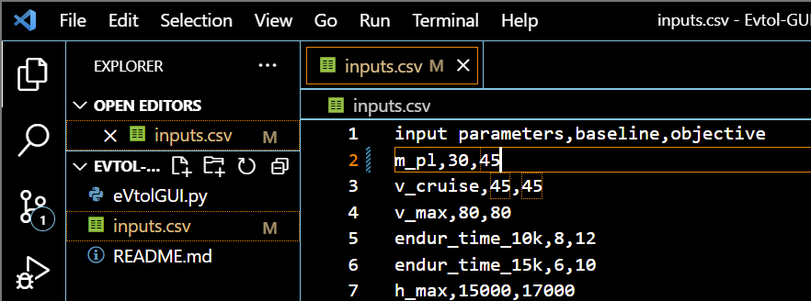
Git tracks your changes
Now, you have a local copy of the repository you just cloned, and Git will monitor your changes
Git is broken up into sections and files can be moved with various commands
The basic workflow of Git:
Clone a repository
Modify a file(s)
Stage a file(s)
Commit the file(s) to be stored in the repo
Push the branch to Github
Initiate a pull request on Github
Review and merge the branches on Github
Untracked files are not stored in Git

Slide 10
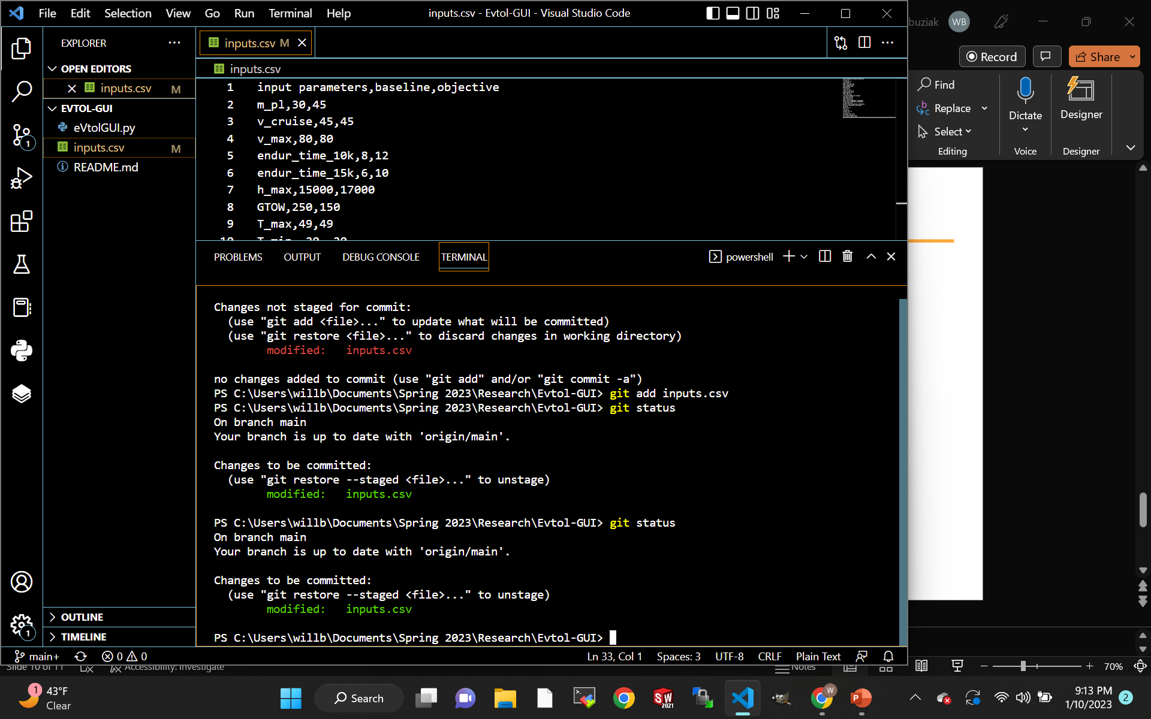
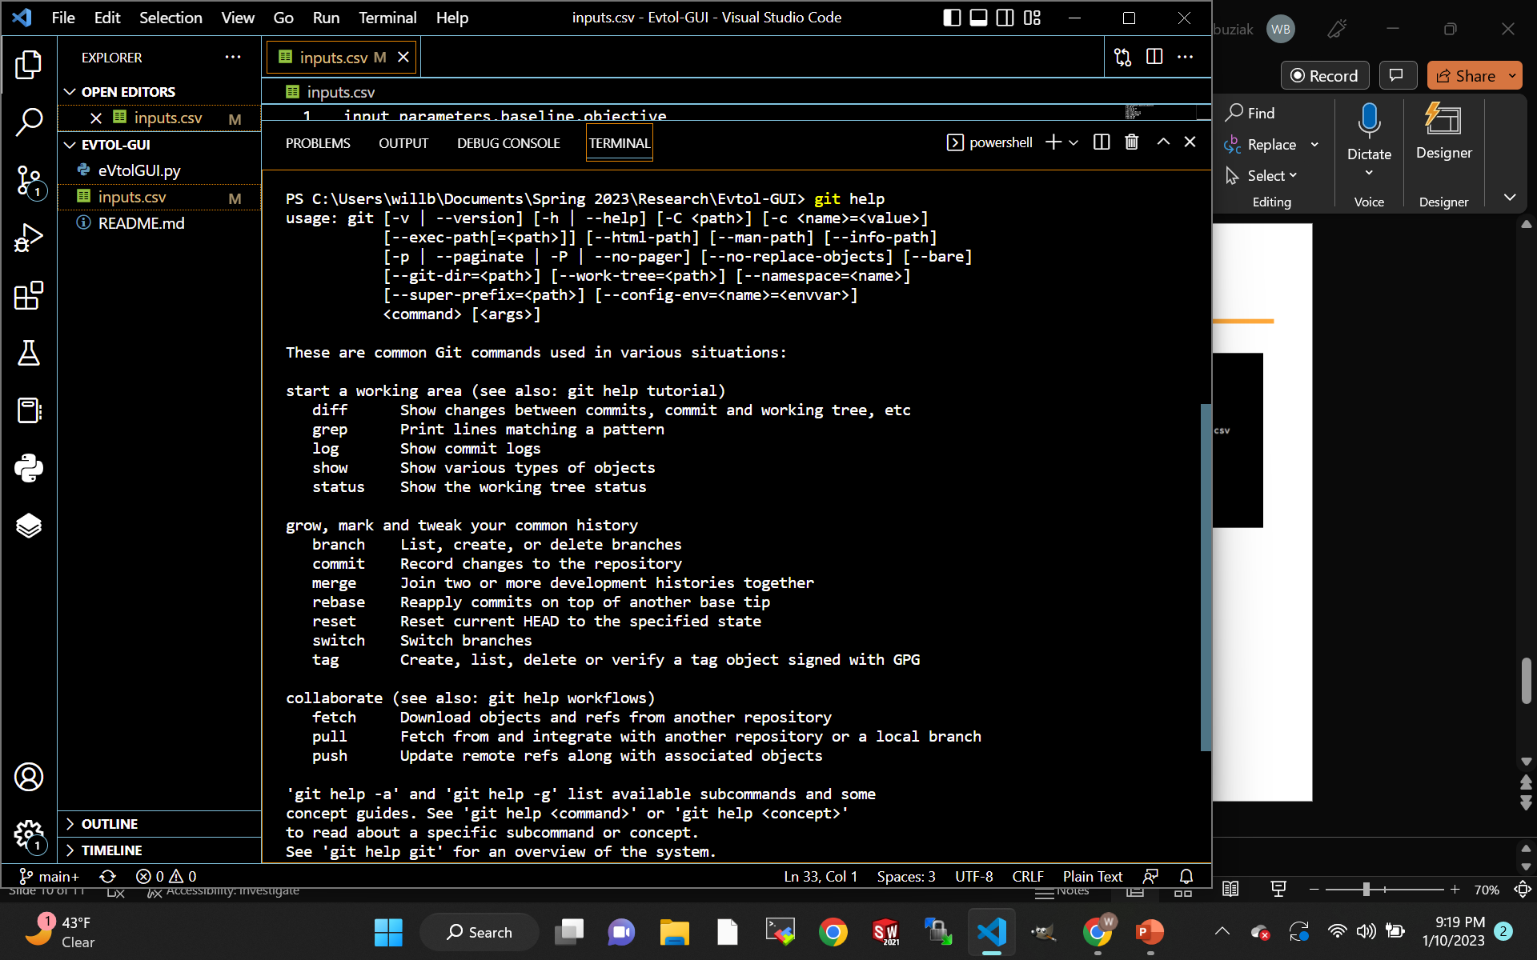
“git status” will report the status of the working directory
The “staging” area is for files that will be pushed in the commit
“git add <file>” moves a file into the staging area
“git restore --staged <file>” removes a file from the staging area
‘git commit -m “<message>”’ commits the staged area for pushing
“git push <remote> <branch>” pushes the branch to Github
“git help” will return an overview of commonly used commands

Slide 11
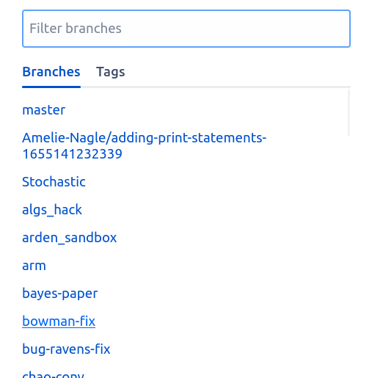
Create a new branch when pushing to Github
Before making major changes, you will want to create a new branch
Switch to a new branch with “git switch -c <branch-name>”
This allows you to develop in isolation from the main branch
Branches can be merged to the main branch with a pull request
“Pull requests” are notifications to collaborators that you have made changes to a branch and seek to merge it to the main branch
Collaborators would then pull these changes

Slide 12
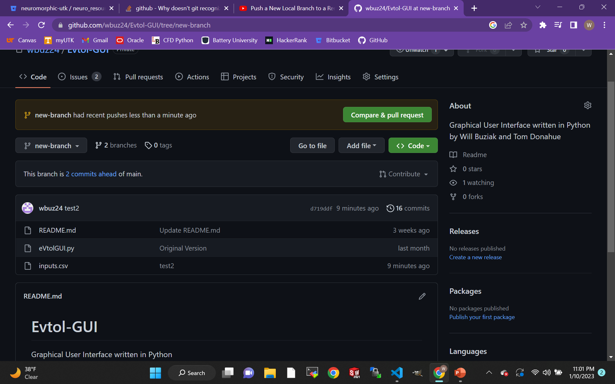
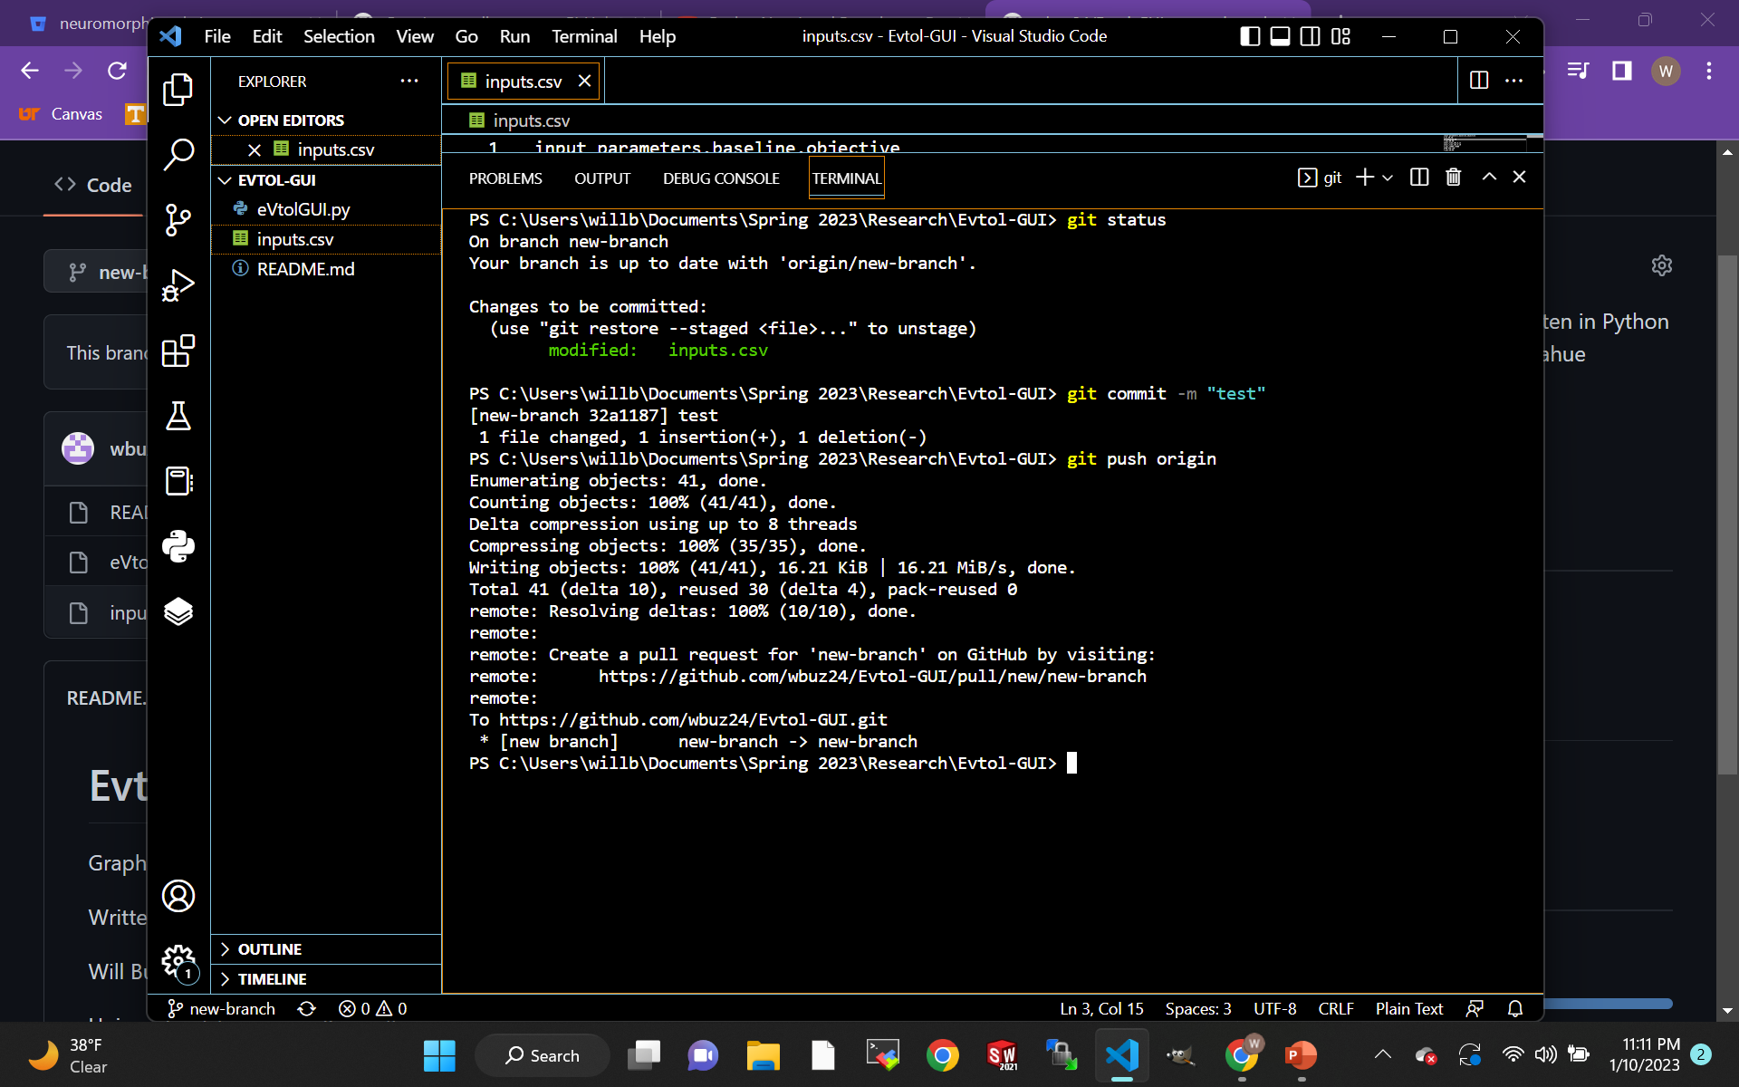
“git switch -c <branch>” creates a new branch
After changes to a file are made:
“git add <file>” adds the file to the stage area
“git commit –m “<message>”” creates a new commit of what is in the stage area with a description
“git push <remote> <branch>” will push your branch to Github and can be seen online
Try “git push --set-upstream <remote> <branch>” to set your upstream push to a default branch

Slide 13
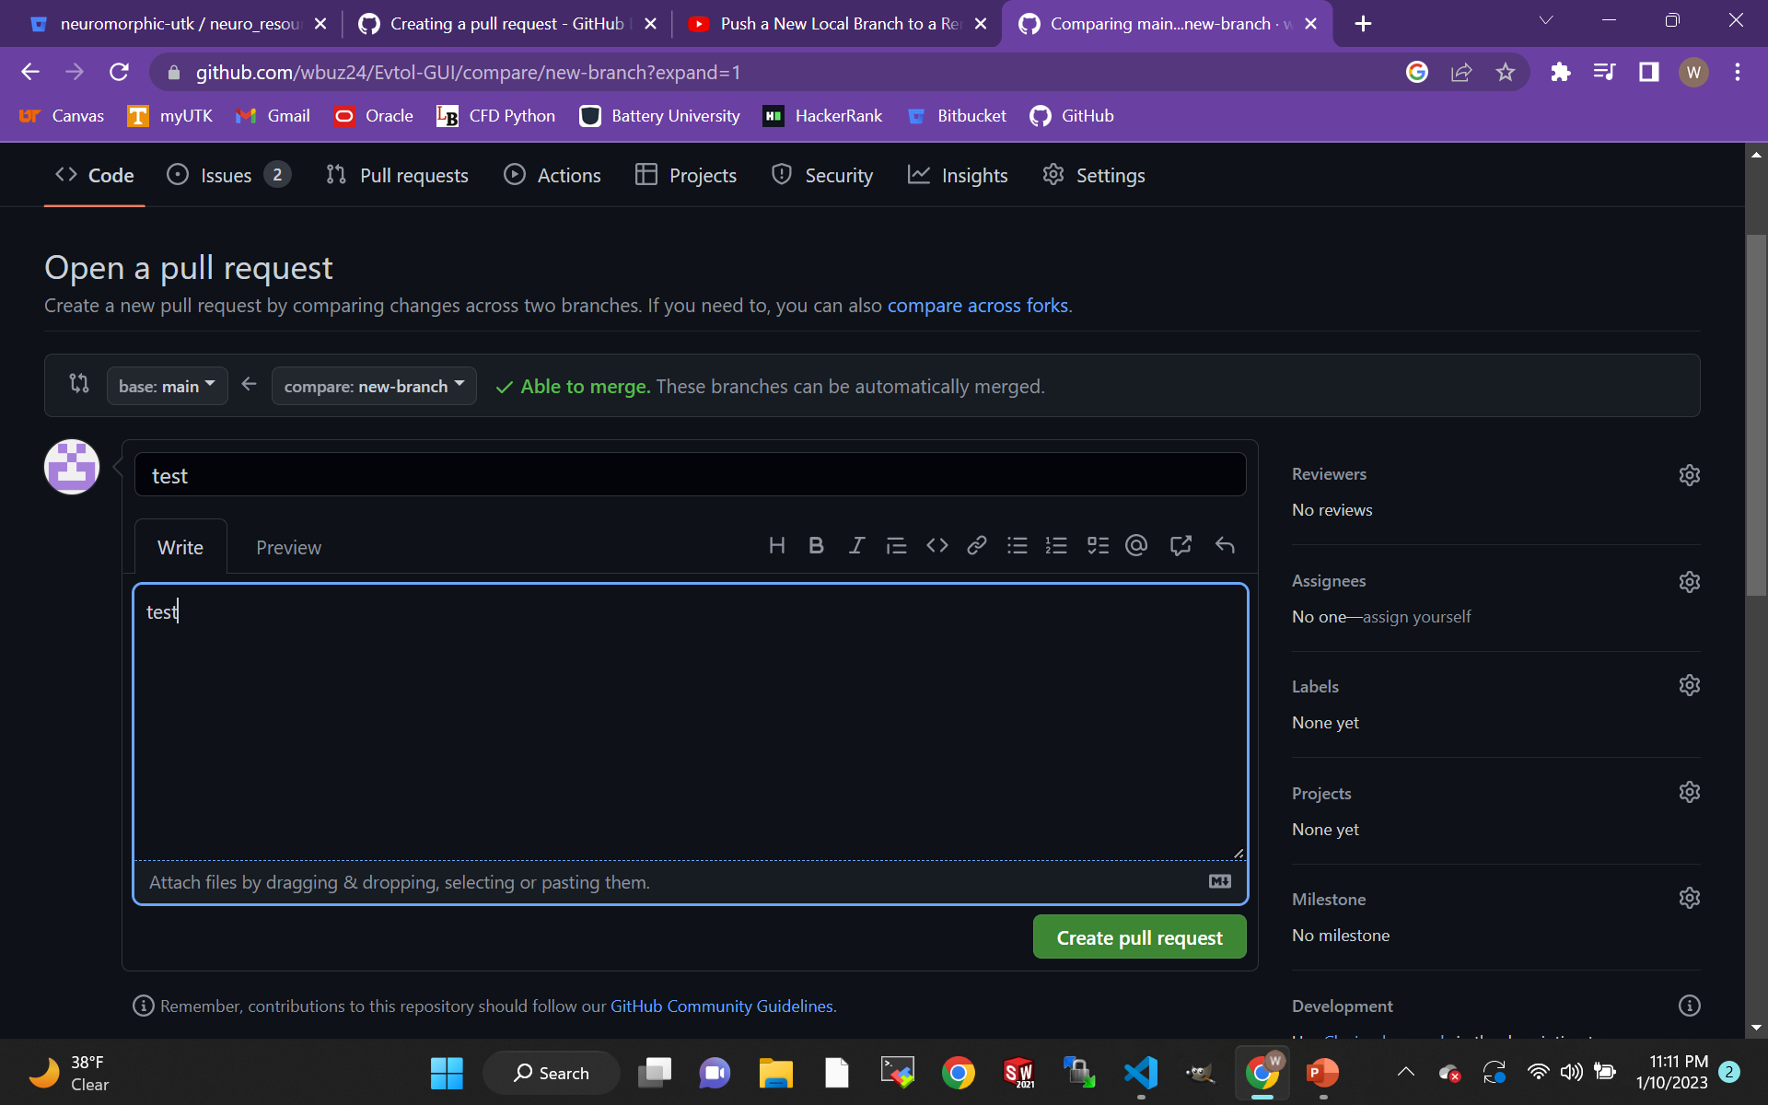
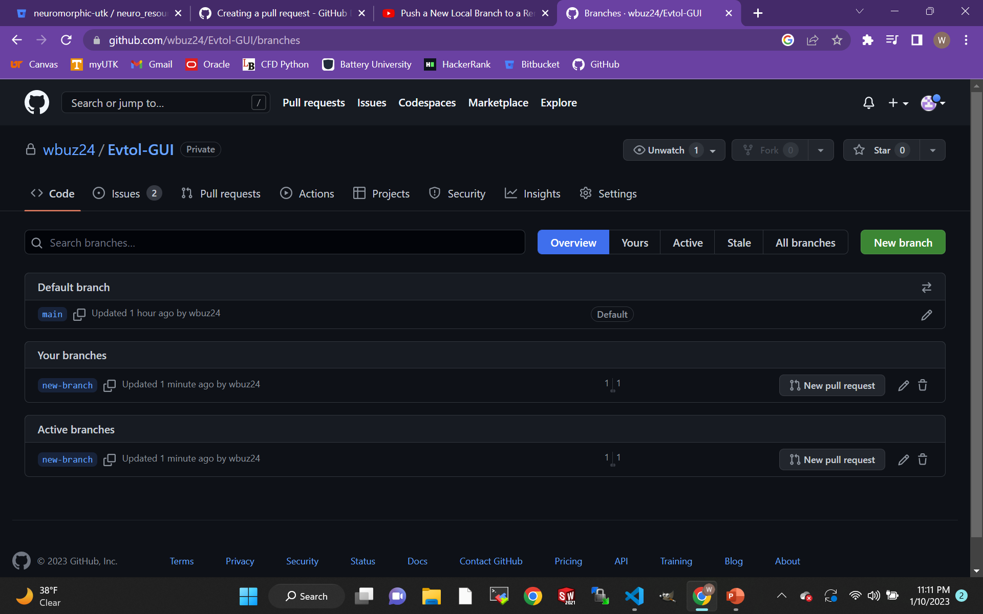
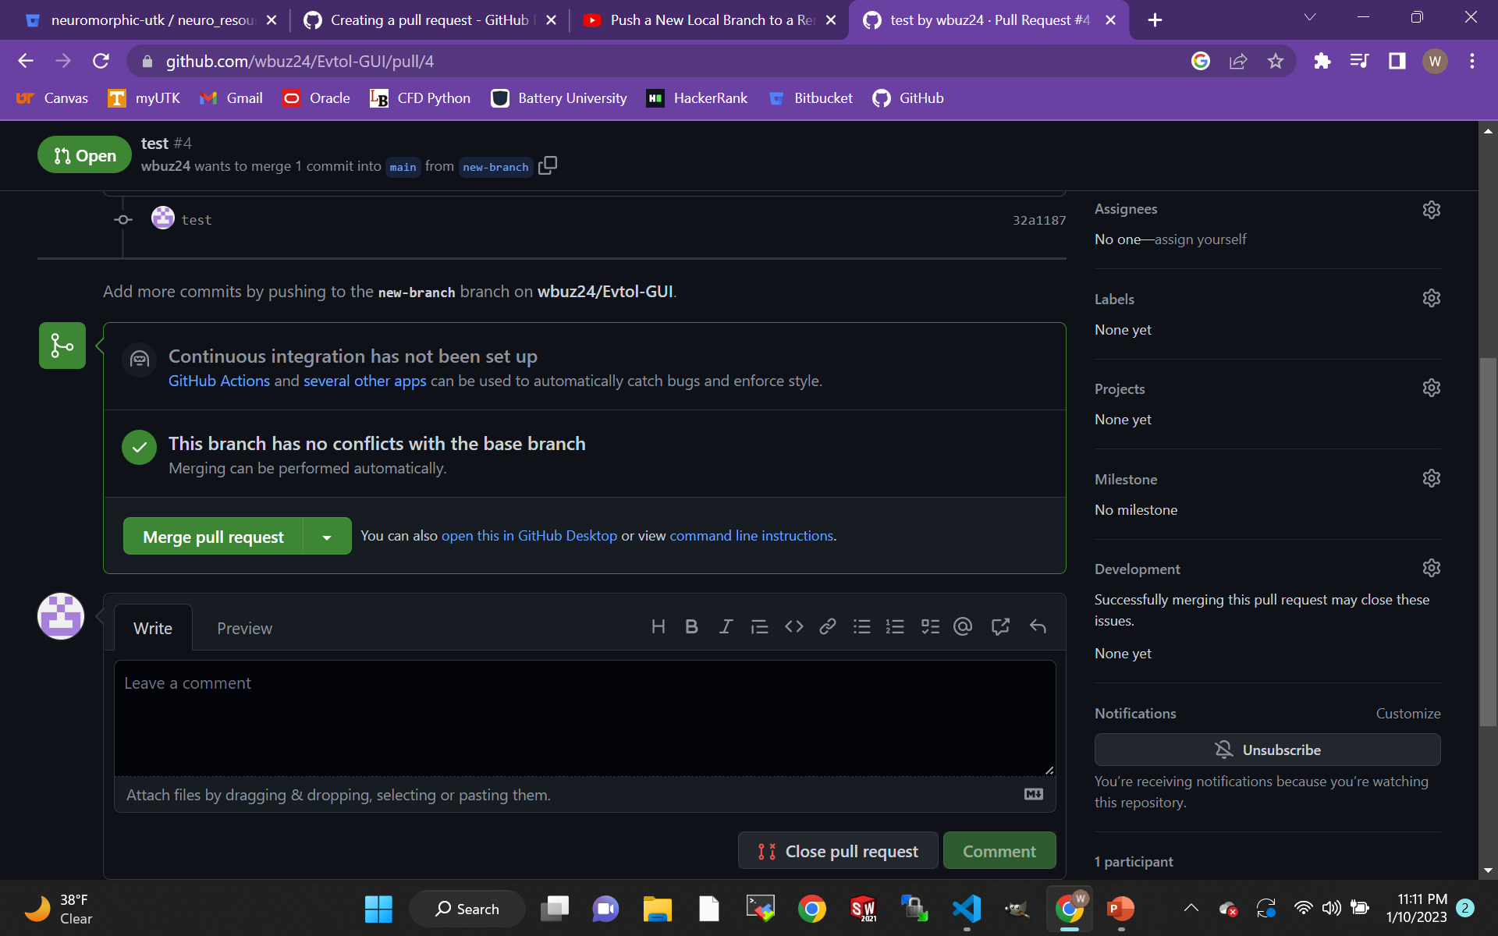
Pull Requests notify collaborators for review
After you have pushed your new branch to Github, you can initiate a pull request to review the code and merge with the main branch
Pull requests can be sent to individual collaborators

Slide 14
Pull before you modify to mitigate conflicts
When a collaborator pushes a branch to Github and merges the changes with the main branch, use “git pull” to update your local copy of the main branch.
It is important that you pull new commits of the main branch before you push your branch to Github, so you merge your collaborators work
"git pull" should be used when the main has updated to avoid overwriting, non-fast forward and other Git errors
When in doubt, check your:
Directory
Git Status
Branch
Commit status
Branch head

Slide 15
Commit before you merge to avoid conflicts
Merge conflicts are inevitable and the quickest solution depends on what you are trying to do.
Often, you seek to pull a branch into a new branch (isolated from what you are currently working on)
Commit your changes
"Checkout" a new branch with your desired branch
git checkout –b <new-branch> <remote/branch>
You can cancel a merge during a conflict:
git reset --merge
Or
git reset --hard HEAD (will reset your branch head)

Slide 16
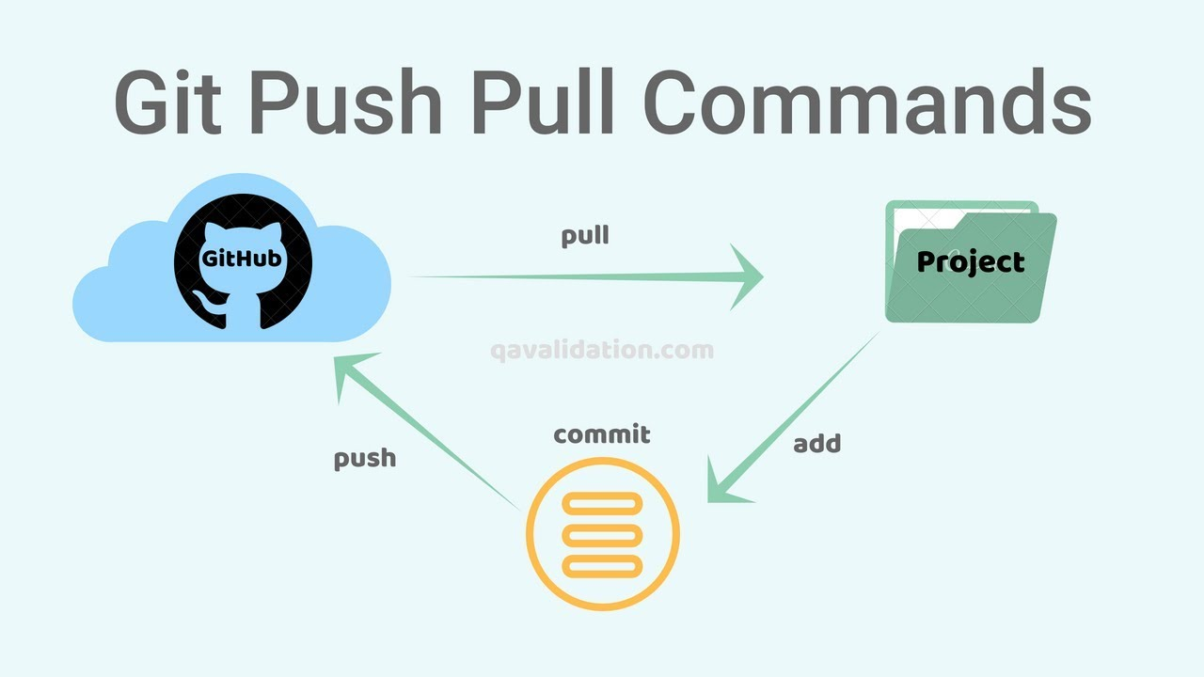
Proper Git usage prevents overwriting
Once your branch is merged to the main branch, it is safe to delete the branch that you had created.
If your local repo is not up to date, you may experience a “non-fast-forward” error

Slide 17
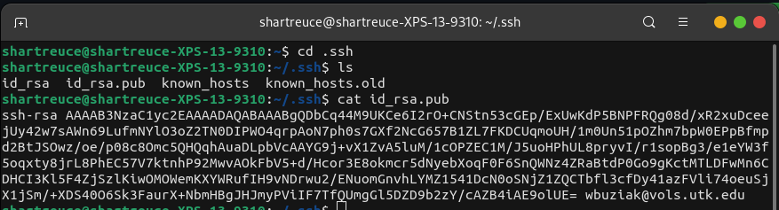
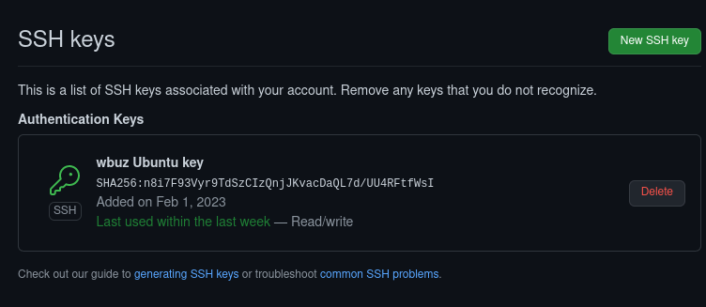
Generating SSH Keys
In your terminal:
ssh-keygen –C "<git.email>"
Default settings work (just press enter until it generates)
Locate your ".ssh" folder (hidden directory)
cd
ls –l -a
cat id_rsa.pub
Copy the key
On Github:
Navigate to Settings > SSH and GPG keys
Create a new key and paste your public key.
Git/Github should now be authenticated and no longer require a password

Slide 18
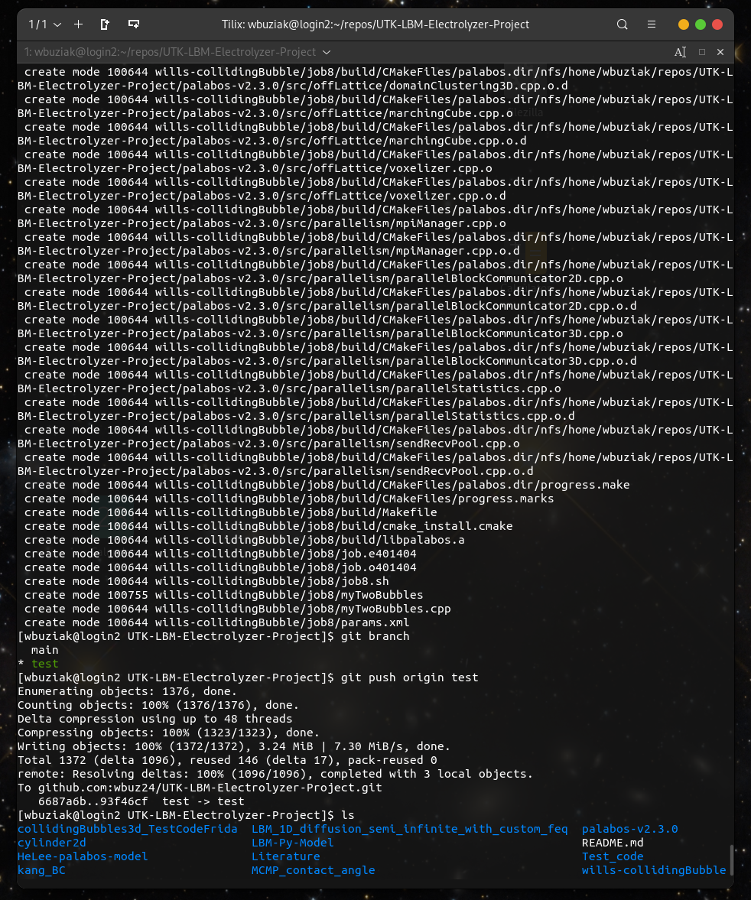
.gitignore & .keep files keep your repo clean
.gitignore tells git specific files in the directory to not track
This is a hidden file (can be found with "ls –l –a")
.gitignore files often include files that are only relevant to your local machine (graphs, images, individual log files, etc.)
.keep tells git to track an otherwise empty directory
Git does not track empty folders by default
.keep files can be used to maintain a structure in a repository
Repositories can quickly fill up with irrelevant files.

Slide 19
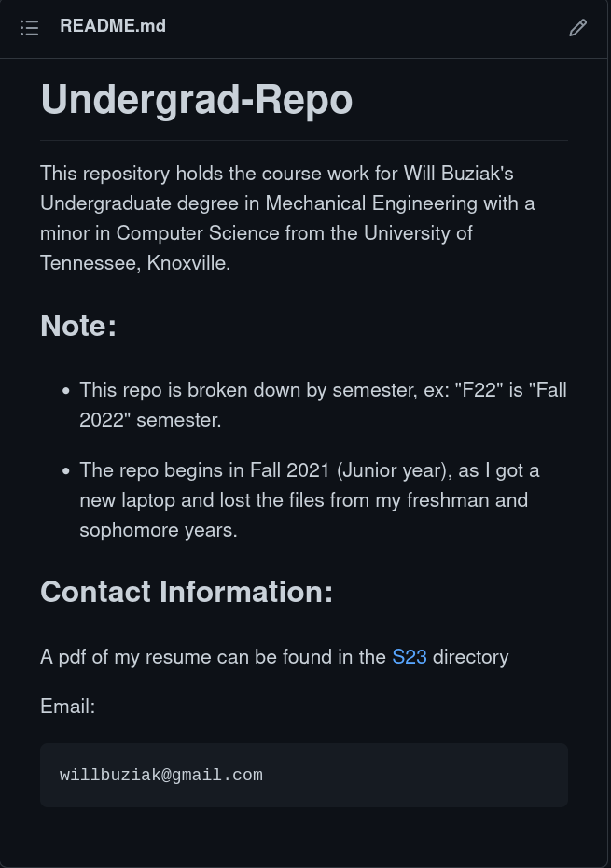
README.md files document your repo
Markdown "README.md" files are an excellent format for documenting repositories
Markdown files support many different formats to highlight different aspects of your code and/or repository
Headers
Copy fields
Hyperlinks
Editable directly from Github

Slide 20
Other Useful Commands - Naming and navigation
“git remote -v” will show all the remotes you have locally and their names
“git remote” can also be used with:
add <name> <URL>
rename <old> <new>
remove <name>
“git switch <branch>” switches to a branch
“-c” flag creates a new branch
“git rm” removes files from a working tree
“git restore” restores a working tree’s files
“git help” lists common commands
"git branch - a"
lists current branch heads
"git checkout –b <new-branch> <origin/branch>
Creates a new branch based on an existing branch
"git merge"
Merges with a given branch
"--quit" flag can cancel the current merge during conflicts
"git config"
Configures your system, default is to the working repo
"--global" applies the config to the entire machine

Slide 21
References
Github Docs
https://docs.github.com/en
https://git-scm.com/book/en/v2/Getting-Started-First-Time-Git-Setup
Tennlab Neuromorphic Research Git presentation
https://bitbucket.org/neuromorphic-utk/neuro_resources/src/master/presentations/git_presentation/images/
“Push a New Local Branch to a Remote GitHub repo with Git”
https://www.youtube.com/watch?v=se1WitSPKwc
"Difference between git PULL and git FETCH"
https://www.youtube.com/watch?v=Mdo7hvlUJ-U
Connecting to Github with SSH\
https://docs.github.com/en/authentication/connecting-to-github-with-ssh
How to Fix Git error: you need to resolve your current index first
https://unfuddle.com/stack/tips-tricks/git-error-you-need-to-resolve-your-current-index-first/
Pull a Remote Branch into a New Branch
https://coderwall.com/p/_gepwq/pull-a-remote-branch-into-a-new-branch

